Slide 1

PRESENTATION ON
“
“
TO VERIFY THE LAWS OF TRANSVERSE VIBRATION OF STRINGS & TO DETERMINE THE FREQUENCY OF A TUNING FORK BY MELDE’S EXPERIMENT.
BY
GROUP - 02
PREPARED BY -
ZANNATUL FERDOUS WAFI | 21-45924-3
SHUVO CHANDRA MALI | 21-45971-3
MD. SHOHANUR RAHMAN SHOHAN | 22-46013-1
MAHNAZ TABASSUM ORPITA | 22-46024-1
RAZI BILLAH | 22-46028-1
Physics 2 Lab
Summer 2021-22
Department of Physics
American International University-Bangladesh
WITH INSIGHT FROM RESPECTED
DR. MD. HABIB ULLAH

Slide 2

TOPICS
Theory
Apparatus
Procedure
Experimental Data
Analysis & Calculation
Result
Discussion

Slide 3
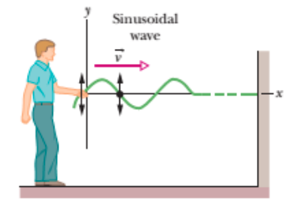
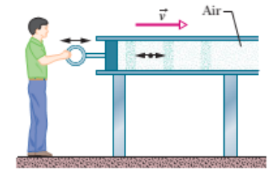
THEORY
Transverse wave : The vibration of the particle of the string is perpendicular to the velocity of the propagation of wave.
Longitudinal wave : The vibration of the particle of the air is parallel to the velocity of the propagation of wave.

Slide 4
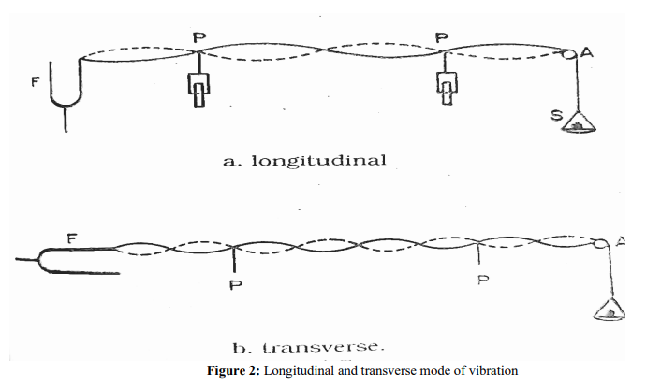
THEORY
The string will be set into vibration by setting the turning fork into vibration. as a result, waves will proceed along the length of the string and will be reflected on reaching the fixed end of the string.
The superposition of the directed and reflected waves will form stationary waves.
If the tension is suitably adjusted the frequency 𝑓 of the fork may be made to equal to the frequency 𝑓 ′ of the fundamental or anyone of the higher tones of the string a resonance is said to have occurred between the fork and the particular mode of vibration of the string.

Slide 5
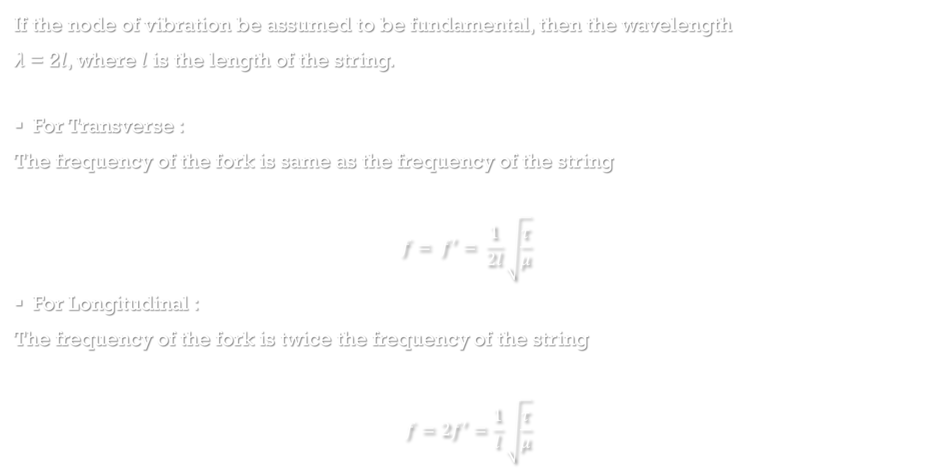
THEORY
If the node of vibration be assumed to be fundamental, then the wavelength
𝜆 = 2𝑙, where 𝑙 is the length of the string.
For Transverse :
The frequency of the fork is same as the frequency of the string
$$f= f^{′}= \frac{1}{2l}\sqrt{\frac{τ}{μ}}$$
For Longitudinal :
The frequency of the fork is twice the frequency of the string
$$f=2f^{′}=\frac{1}{l}\sqrt{\frac{τ}{μ}}$$

Slide 6
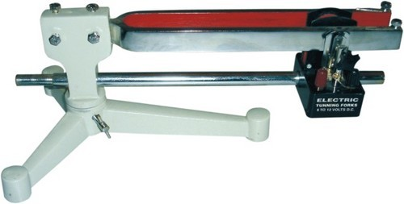
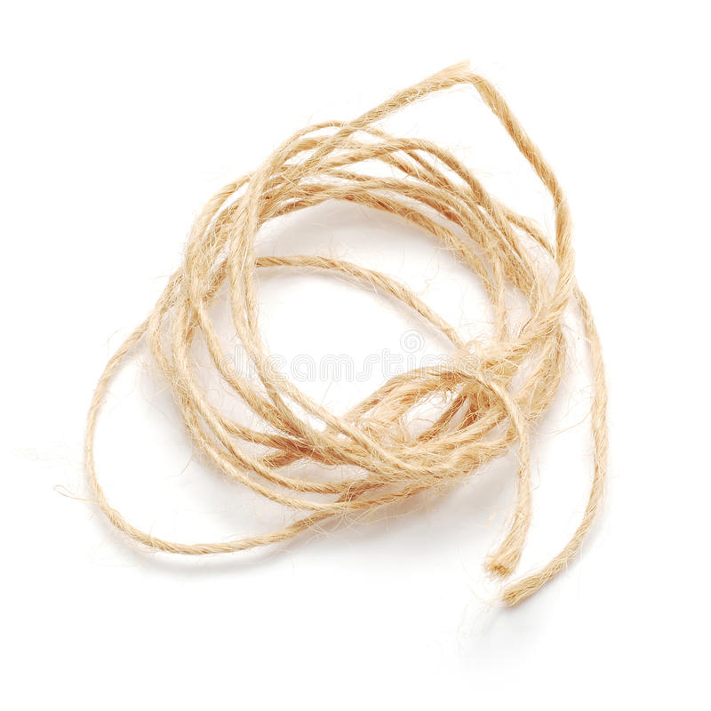
APPARATUS
The components required to carry out this experiment include: -
• Melde’s apparatus (electrically maintained
tuning fork)
• String

Slide 7
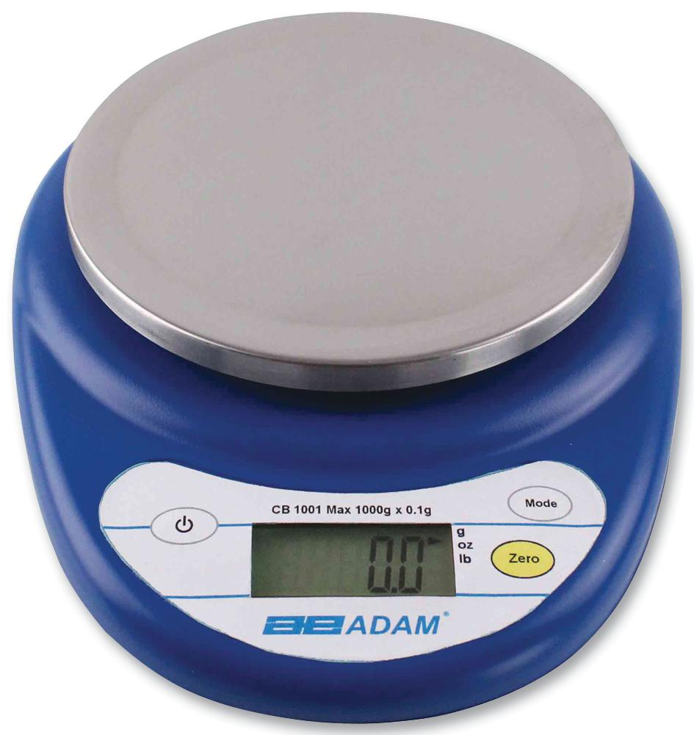
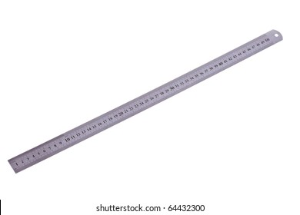
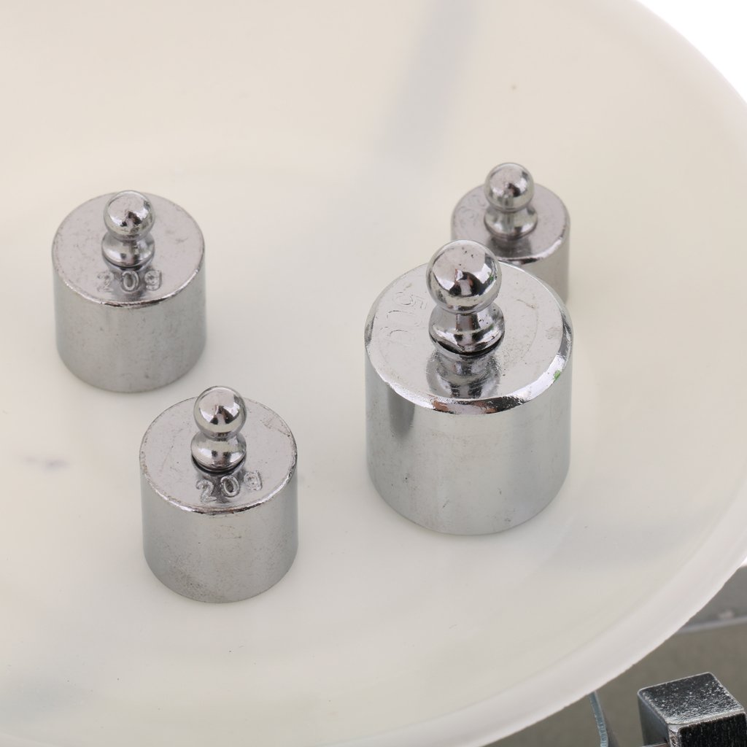

APPARATUS
• Electronic balance
• Meter Ruler
• Pan (to hold the weights)

Slide 8
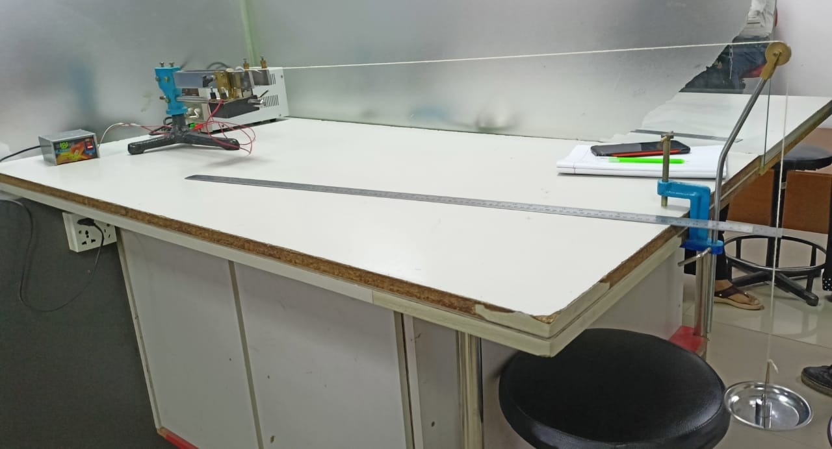


FORK
PULLY
STRING
METER RULLER
POWER SUPPLY
Pan (to hold the weights

Slide 9
PROCEDURE
Connect the primary of the stepdown transformer to A.C mains, while the secondary to the given point of electrically maintained tuning fork.
Tight the one end of thread to the prong of tuning fork and other end to a scale pan. Hang the scale pan with pulley that is fixed at end of table.
Move the tuning fork toward or away from pulley to adjust the length of thread, so that loops could be formed. Now measure the length thread for one and two loop when stable loops are formed in horizontal plane. This will give the value l for one and two loops.
Now increase the mass on scale pan (m=20, 40 gm) and repeat the step 3.

Slide 10
PROCEDURE
Move the tuning fork toward or away from pulley to adjust the length of thread, so that loops could be formed. Now measure the length thread for one and two loop when stable loops are formed in transverse plane. This will give the value l for one and two loops. The observed length should come double length of transverse case.
Now increase the mass on scale pan (m=20, 50 gm) and repeat the step 5 for this arrangement.
Find out length of thread per loop (l/p) for each case of load.
Measure the mass (m) of 10m length of thread and mass of scale pan (mP). Value of m/10 gives mass per unit length of thread.
Calculate frequency of tuning fork for transverse case using M, m and l/p,

Slide 11

Experimental Data
Mass of the scale pan, w = 23.7g
Length of the string L = 200 cm
Mass of the string, M = 0.7g
So, the mass per unit length of the thread, 𝜇 = $\frac{M}{L}$ = $\frac{0.7}{200}$ = 0.0035 gm/cm

Slide 12

Experimental Data
Table-1: Table for transverse position
No of Observation | Total no of loops between the fixed ends | Load on the scale pan 𝒘𝒕 (gm) | Tension, $τ$ = (𝒘+𝒘𝒕) 𝒈 (dynes) | Distance between the pins G (cm) | No of loops between the pins N | Length of a segment $l=\frac{G}{N}$ (cm) | Frequency of the fork f f’ = $\frac{1}{2l}\sqrt{\frac{τ}{μ}}$ (Vibration/sec) | Mean frequency f₂ (Vibration/sec) | $\frac{τ}{l^{2}}$= constant
1 | 4 | 0 | 23226 | 101.5 | 4 | 25.37 | 50.76 | 51.35 | 36.07
2 | 3 | 20 | 42826 | 101.5 | 3 | 33.83 | 51.69 |  | 37.41
3 | 2 | 50 | 72226 | 88 | 2 | 44 | 51.61 |  | 47.30

Slide 13




ANALYSIS & CALCULATION
Frequency of the fork = $\frac{1}{2l}\sqrt{\frac{τ}{μ}}=\frac{1}{2 × 25.37} \sqrt{\frac{23226}{0.0035}}=\text{50.76}$ (Vibration/sec)
[ When no. of loop is 4 ]
Frequency of the fork = $\frac{1}{2l}\sqrt{\frac{τ}{μ}}=\frac{1}{2 × 33.83} \sqrt{\frac{42826}{0.0035}}=$ 51.69 (Vibration/sec)
[ When no. of loop is 3 ]
Frequency of the fork = $\frac{1}{2l}\sqrt{\frac{τ}{μ}}=\frac{1}{2 × 44} \sqrt{\frac{72226}{0.0035}}=\text{5}\text{1}\text{.6}\text{1}$ (Vibration/sec)
[ When no. of loop is 2 ]
Mean Frequency = $\frac{ 50.76 + 51.69 + 51.61 }{3} =\text{5}\text{1}\text{.}\text{35}$ (Vibration/sec)

Slide 14

Result
The law of transverse of string is verified by showing $\frac{τ}{l^{2}}$= constant and the frequency of the tuning fork is 51.35 (Vibration/sec).

Slide 15
Discussion
This experiment was conducted to verify the laws of transverse and longitudinal vibration of strings and to determine the frequency of a tuning fork by Melde's experiment. The main objective of this experiment is to find out the frequency of an electrically maintained tuning fork by transverse mode of vibration and longitudinal mode of vibration.
While conducting this experiment, adjustment (of the fork) is done as fork-end and weight must produce nodes. Amplitude is max when fork frequency is equal to the string frequency when vibrating.
Loop measurements must be taken when the loops are stable. Length measurements must be taken with ruler parallel to the measuring component to avoid incorrect readings.

Slide 16
Discussion
Systematic error (zero error) of the electronic balance along with human parallax error may account for inaccurate measurements.
Essentially a low-risk experiment however adequate safety procedures should always be appropriated. Since an electronic equipment is being utilized, this experiment prompts a fire-hazard so fire-extinguishers should be kept nearby.

Slide 17


THANK YOU

